Slide 1
An Introduction to STATA
Prof Patrick Musonda
Lead Medical Statistician
University of Zambia
School of Public Health
pmuzho@hotmail.com
An Introduction to Statistical analysis using STATA

Slide 2
Course contents
General introduction
Some basic commands
Data input and output
Graphical displays
Comparing two groups (Continuous variables)
Comparing two groups (Categorical variables)
If time allows, I may do introduction to survival data
An Introduction to Statistical analysis using STATA

Slide 3
General Introduction
Introduction to Stata software and its applications
Not possible to cover all applications of STATA in a term
Nor even a year’s course to be honest
There may be more than one way to do a particular activity in Stata
We may just present how to do a particular thing in a particular way
But that should not mean that is the only way of doing things
An Introduction to Statistical analysis using STATA

Slide 4
General Introduction
I have my own biases why I choose to present the applications of stata in the way the course is designed
Most of you may have used STATA in one way or the other
But in this course, I assume no previous knowledge, but also assume that you are using stata 11 as opposed to any other higher version or lower version. But all ideas taught can be applied in any higher version of stata.
As the result, the course will start off very slowly
I ask you to hold your fire if you may feel the course is too shallow
It will get hard and intense in the next few days
An Introduction to Statistical analysis using STATA

Slide 5
General Introduction
If a particular activity being presented you may know a different way of doing it
I suggest you keep that knowledge to yourself but try and learn what I will be teaching you
STATA has evolved over the years
I have been using STATA in the last 21 years (from versiton 5), believe you me, STATA now is different
The first version use to be only command driven
But now there are a lot of menu applications, point and click like SPSS
An Introduction to Statistical analysis using STATA

Slide 6
General Introduction
Because I consider myself as a traditionalists, I will omit all point and click applications
Because I think you can appreciate STATA better with the traditional way as presented in the course
I call traditional way when we are using mainly commands, and later in the course I will evolve to using do files
Nearly all topics covered in this course can be considered introductory
I will not cover everything that STATA can do for the particular topic
An Introduction to Statistical analysis using STATA

Slide 7
General Introduction
But I hope by the end of the course,
if you will be wanting to do something I have not covered
By using the help facilities of STATA, you should be able to do something that I have not covered
I hope you should be able to enter data directly in STATA, import it from other sources, do a reasonable amount of data management
Transform data, do some descriptive statistics, create some graphs
An Introduction to Statistical analysis using STATA

Slide 8
General Introduction
Do some statistical analysis of comparing two groups,
Both when dealing with continuous data and categorical
Do a simple and multivariate regression, interpret the results from Stata
An Introduction to Statistical analysis using STATA

Slide 9
General Introduction
Everything taught on the course has been written down in the hand-outs
The format will be looking at some content in the Hand-outs
Doing some practical activities in STATA
Following demonstrations by the instructor on the projector
Participants asking questions as needed and reproducuing what is being demonstrated
An Introduction to Statistical analysis using STATA

Slide 10
What is STATA
Statistical Package for Medical Statisticians
  Commonly used by students in: Psychology, Sociology, psychiatry, Economic students and now Health Economic students and other disciplines
Commonly used package for
  Storing datasets
  Manipulating datasets
  Producing tables and graphs
  Statistical analysis (Univariate-t-tests, multivariate regression…)
  Concentrate on getting results, interpretation, some theoretical background, more advanced procedures references are given
An Introduction to Statistical analysis using STATA

Slide 11
Getting Help
On line help through Help menu
You need to go to the help menu as in the next slide to find out about things
Can type the: help …. Name of command
Through out the course, we will advise you when to use the help facility
Can use the command: findit … Name of a particular problem, only useful if computer connected to internet
An Introduction to Statistical analysis using STATA

Slide 12
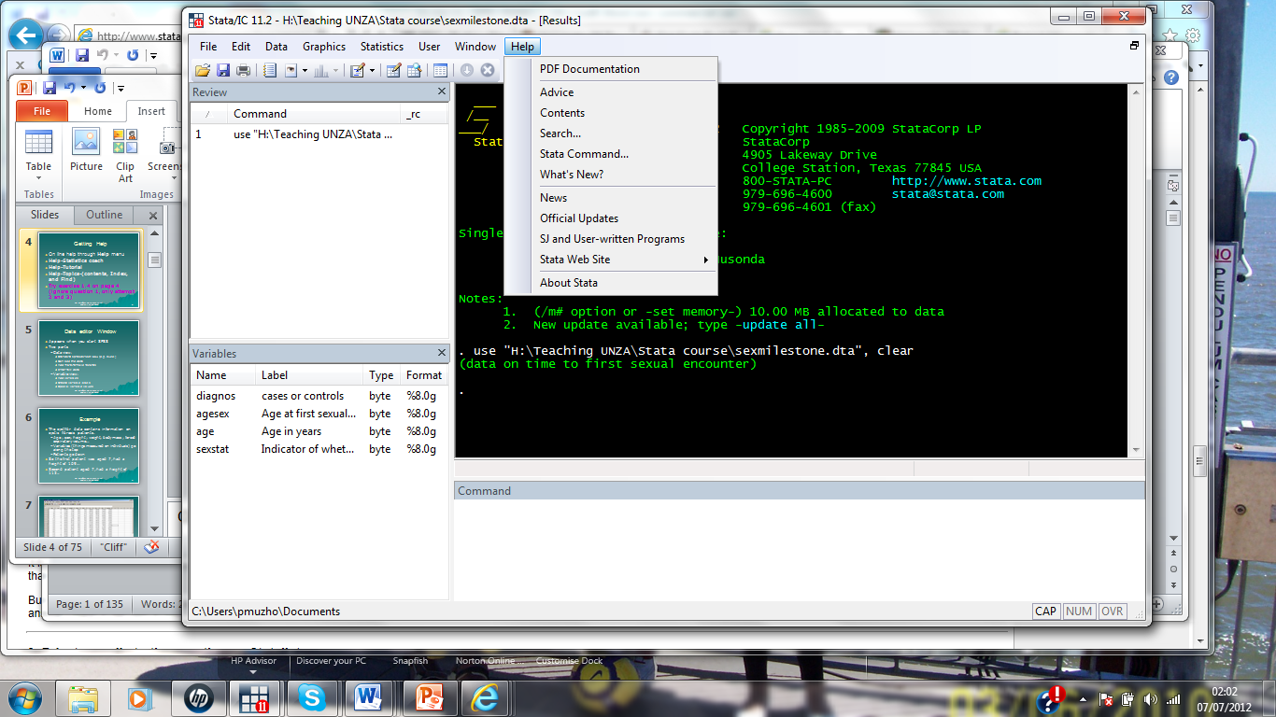
D
An Introduction to Statistical analysis using STATA

Slide 13
Introduction Continues
You need to be comfortable with Stata windows in particular the
The variable view window, the command window, the results window, review and review window (see Figure 0.1 in hand out),
It is not always that one will need these windows to get on.
An Introduction to Statistical analysis using STATA

Slide 14
Chapter 0 of Handout
Working directory –where stata expects to find the data, is shown at the foot of the screen on the left (See Figure 0.1)
There is usually a default working directory when STATA is first opened, but this can be changed
Later on the course, we shall show how this can be changed
Command window-used to type in commands, stata is case sensitive, so “A” is not the same as “a”
Edit commands by clicking at the command in the “Review” window
An Introduction to Statistical analysis using STATA

Slide 15
Chapter 0 of Handout
When a command is executed, it appears in the “Results” window with a dot in front
This is referred to as the “Stata prompt”, it distinguishes between commands and results
Previously run commands can be retrieved using Page-Up key
See page 2 for a number of different windows that will be used in the course including :
save, log begin/close/suspend/resume, data editor (browse), data editor (edit), new Do-file editor, file, break, exit, etc
An Introduction to Statistical analysis using STATA

Slide 16
Chapter 1 of Handout
We introduce loading data already in stata format,
finding out names in the data set, list and browse data, simple tables, generate new variables
Sorting data and how to use stata as a calculator
Variables in births data set
Sex of baby is coded using both numbers in the variable sex and also using alphabetical characters in the variable sexalph
Sequence of characters like “male” or “age 1990” is called a string and variables that hold such characters are called string variables
An Introduction to Statistical analysis using STATA

Slide 17
Chapter 1 of Handout
Variables that hold numeric data are called numeric variables
In the births dataset, sex is a numeric variable while sexalph is called a string variable
Change directory before loading data using directory where data is saved e.g.
cd “F:\mem2\Teaching UNZA\Stata course\2014\Data”
Your directory will be different, this command is telling stata to read data saved in the folder “data”
Either use the command: use births, clear
or use the File>Open>mem2>Teaching UNZA>Stata course>Data>births.dta
//the above command will not apply for your computer, unless where you data is
An Introduction to Statistical analysis using STATA

Slide 18
Chapter 1 of Handout
use "F:\mem2\Teaching UNZA\Stata course\Data\births.dta", clear
Browse the data, browse
A spreadsheet similar to Figure 1.1 in the hand out
See variables in the data in variables window or type:
describe or de or des or desc
Summary data by typing: summarize or summ
Summ gestwks, detail
An Introduction to Statistical analysis using STATA

Slide 19
Chapter 1 of Handout
Missing values are usually coded (dot) for numeric and blank for string variables (stata default)
Other coding can be used, this is usually not advisable
Command codebook is useful to see missing values
Type: codebook
Or more specifically: codebook gestwks
To see values, the command list is useful, e.g.
list or list matage
An Introduction to Statistical analysis using STATA

Slide 20
Chapter 1 of Handout
Stata stops after each screenful of output,
Click on clear-more-condition, OR break button to break the screen, space bar or enter for another screen full
Restricting listing observation say from 1.2. …, 5 type:
list matage in 1/5 or list matage bweight in 11/20
Listing without observation number type: list in 1/5, noobs
Looking at distributions of categorical variable:
tabulate hyp, tabulate sex
An Introduction to Statistical analysis using STATA

Slide 21
Chapter 1 of Handout
Cross tabulations:
tabulate hyp sex, tabulate hyp sex, row , tabulate hyp sex, col
tabulate hyp sex, row col, tabulate hyp sex, cell
Using table command for more general tables
table sex, table sex, contents(freq mean bweight sd bweight)
table sex, c(freq median bweight p25 bweight p75 bweight)
table sex, c(freq count gestwks median gestwks)
An Introduction to Statistical analysis using STATA

Slide 22
Chapter 1 of Handout
Stata commands can be restricted
E.g. with list command, we used the “in 1/6”
Also the if followed by a logical expression,
E.g. listing birth weight less than 2000g
list bweight if bweight < 2000
Other useful logical expression are X==Y for equal
X<=Y for less or equal
An Introduction to Statistical analysis using STATA

Slide 23
Chapter 1 of Handout
X>=Y for greater or equal
X!=Y or X~=Y for not equal
Common error is to use = (one equal sign) in logical expression instead of == (two equal signs)
command always using logical expression is count
count if bweight <= 2000 & sex==1
count if bweight <=2000|bweight>4000
An Introduction to Statistical analysis using STATA

Slide 24
Chapter 1 of Handout
Generating new variables we normally use the command: generate, e.g. generate num1=1, generate num2=2, then browse
Also we can generate new variables from existing ones by using mathematical operations such as:
+ - * / ln exp ^ sqrt (addition, subtraction, multiplication, division, natural logarithms, exponential, power and square root respectively)
generate num3=num1+num2, generate num4=num1/num2
generate logbw=ln(bweight)
list num1 num2 num3 num4 logbw in 1/9
An Introduction to Statistical analysis using STATA

Slide 25
Chapter 1 of Handout
The command replace is used to change values
E.g. : replace num1=7 or replace num1=35 if hyp==1
describe (will show variables in their current order)
To change the order so that id and sex come first, type:
order id sex, and then describe
Variables that are not needed can be dropped e.g.
drop logbw num1 num2
An Introduction to Statistical analysis using STATA

Slide 26
Chapter 1 of Handout
The opposite is the keep command to keep only a few variables
Sometimes only certain values may be needed to be dropped or kept e.g. drop if sex==1
NB. Once variables have been dropped, there is no way of getting them back other than reloading the data if you have not pressed the “save” button, then original data will be reloaded
Stata can sort the records in a file according to value (numeric or string)
list id matage sex sexalph in 1/10 followed by: sort matage
An Introduction to Statistical analysis using STATA

Slide 27
Chapter 1 of Handout
list id matage sex sexalph in 1/10
sort matage id , followed by: list id matage sex sexalph in 1/10
sort sexalph, followed by: list id matage sex sexalph in 1/10
Stata can be used as a calculator, to do this we use the command display
display 2+2, display 2^3, display ln(10), display sqrt(25)
Can also be used to display text
display “The natural logarithm of 10 is “ ln(10)
An Introduction to Statistical analysis using STATA

Slide 28
Chapter 1 of Handout
display as text “Square root of 25 is “ as result sqrt(25)
Key words “as text” and “as result” determine the colours
Standard probability functions are available, for example probability below 1.96 in a standard normal (i.e. Gaussian) distribution with
display normal(1.96) and other probability functions exist, see hand out on page 29
SHORTCUTS
Variables can be abbreviated as long as the abbreviation is unique:
list id matage hyp gestwks in 1/10
An Introduction to Statistical analysis using STATA

Slide 29
Chapter 1 of Handout
list id mat hy gest in 1/10, or list i m h g in 1/10
list id-gestwks in 1/10, or list i-g in 1/10
Also a shortcut if a variable share some unique initial letters like:
list se* in 1/10, sum matage, l matage in 1/10, br matage, tab sex
The above will give summarise, list, browse and tabulate.
Stata syntax
Here the syntax refers the rules which govern how a stata command is put together
An Introduction to Statistical analysis using STATA

Slide 30
Chapter 1 of Handout
Any stata command take the form:
command varlist if_expression in_range, options
use births, clear or list bweight hyp if sex==1, noobs
Stata help facilities
Through stata help menu or by typing the command: help
E.g. help list
Now do Exercise 1 on page 34
An Introduction to Statistical analysis using STATA

Slide 31
Summary
Stata
  Stata window
  Various buttons in the main stata window
  Changing directories
  Loading data in stata format
  Browsing data
Statistics (Review)
  Listing data
  Summarising data both continuous and categorical
  Using if condition, keeping and dropping variables
  Sorting, generating new variable and using stata as a calculator
An Introduction to Statistical analysis using STATA

